Slide 1
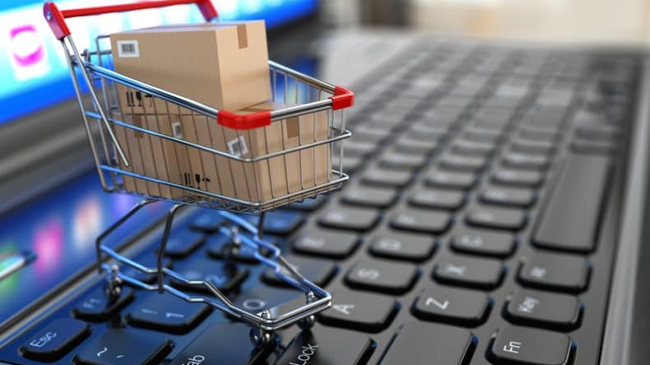

FORECARTZ
GROUP MEMBERS :
GANESH MAJI.
SOUVIK CHAKRABORTY.
CHARAN.
ANKIT BISWAL K.

Slide 2
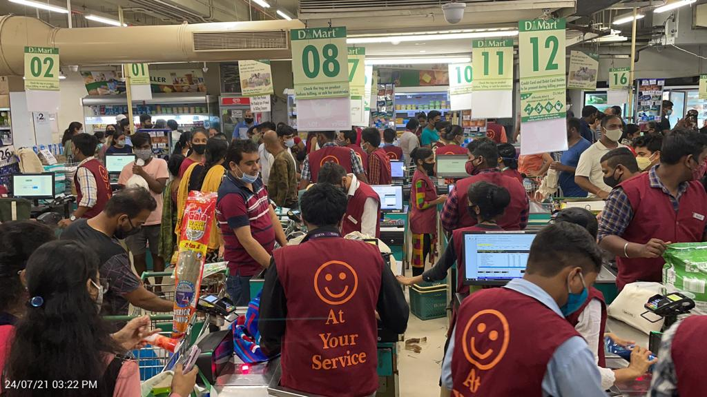
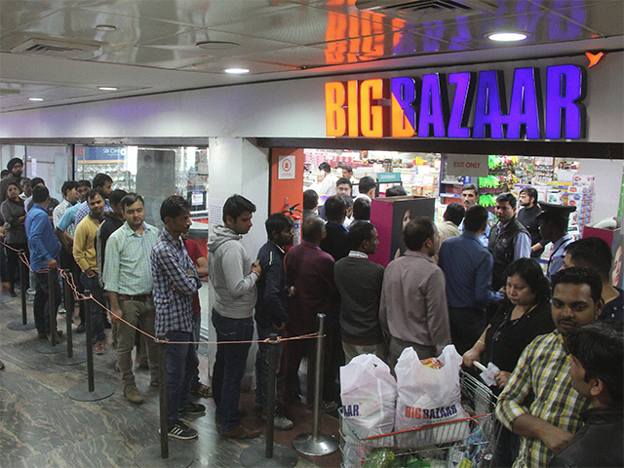
PROBLEM STATEMENT
Long checkout lines in shopping malls
Time-consuming processes
These issues often lead to customer frustration and reduced satisfaction
salary is spend on cashier employee’s

Slide 3
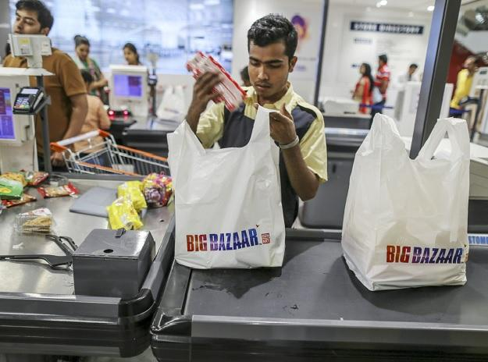
Cashier :
Manual power :
Each bill carries of average 2.5minutes.
Line of 4 persons average store in 1 counter
Line keep growing 2 person per 5 minute.
Avg cashier salary : 7k to 10k
No of employee assigned per store: 6-15
1000sqft : 2 employee 1 desk
Average number in store : 6-8 cashier.

Slide 4
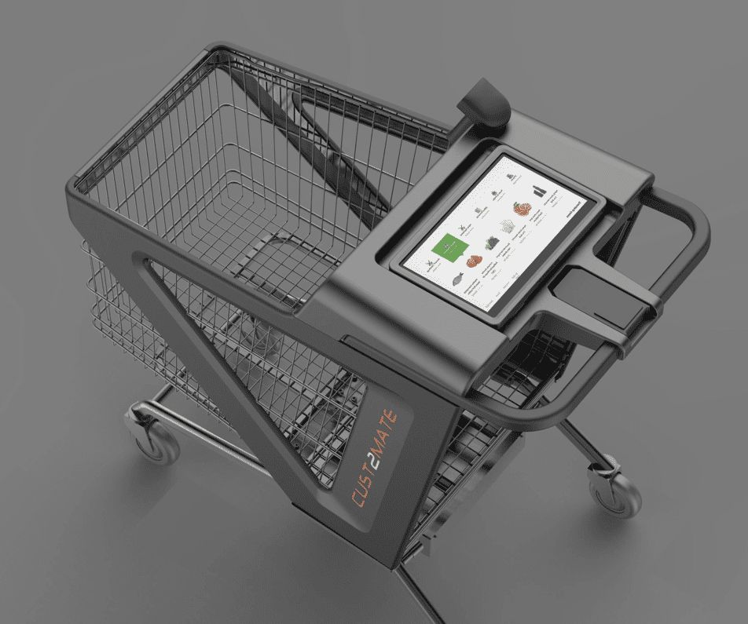
Market price of a
smart cart many
feature
may not required
for the general
store price 4lakhs
10,000$ : price

Slide 5
PRODUCT MODEL AND CIRCUIT

Slide 6
Category A : Model
Target market : general store.
Phone required to payment gateway and see the list of products.
Product price : 7000 rupees .
Subscription retailer (store owner) : 1.2% : 84 rupees.

Slide 7
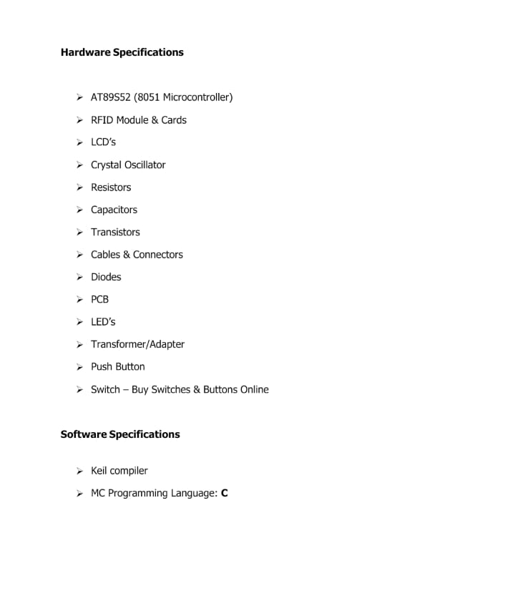
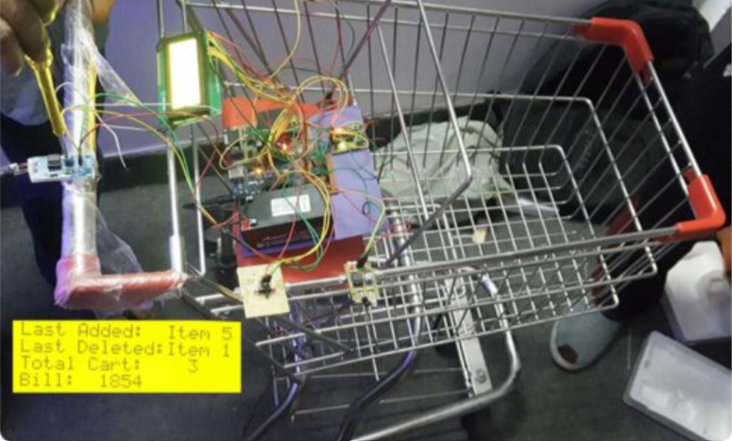
Category a model : basic system all product cost : 6,789 rupees “ data as per amazon”

Slide 8
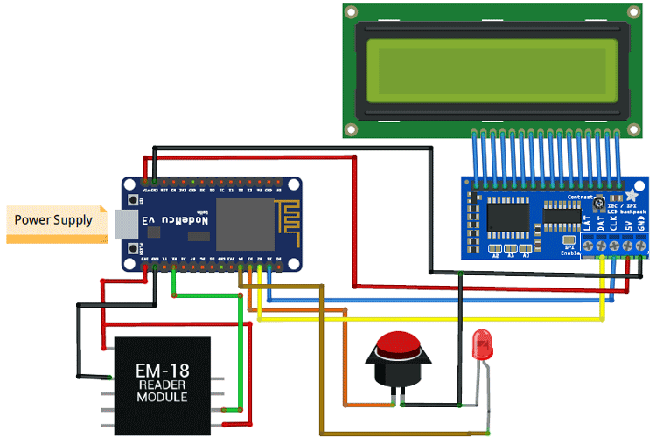
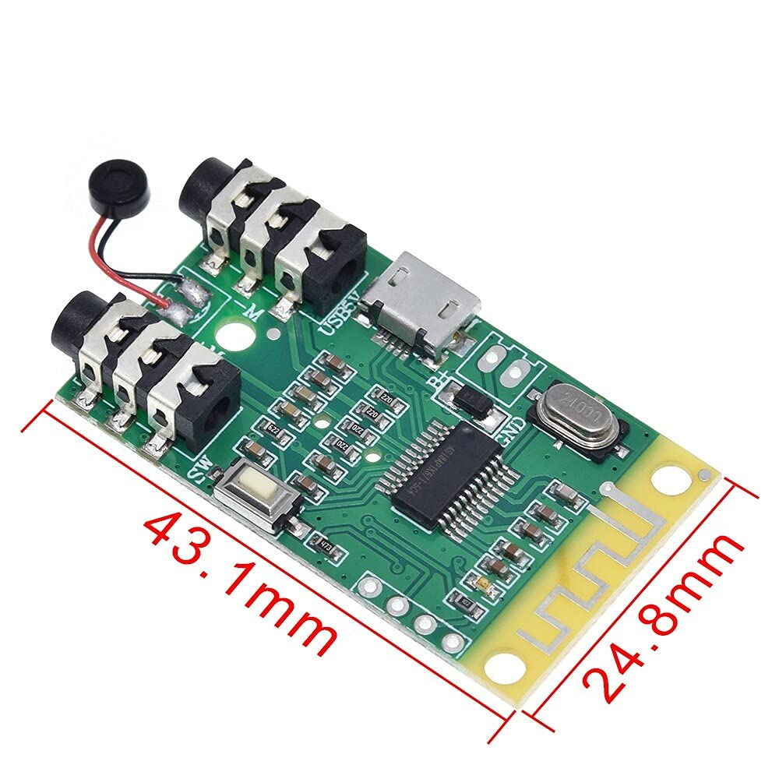
#include <Wire.h>
#include <LiquidCrystal_I2C.h>
#include <MFRC522.h>
#include <SPI.h>
// RFID Setup
#define SS_PIN 10
#define RST_PIN 9
MFRC522 rfid(SS_PIN, RST_PIN);
// LCD Display Setup
LiquidCrystal_I2C lcd(0x27, 16, 2);
void setup() {
Serial.begin(9600);
lcd.begin(16, 2);
lcd.print("Smart Trolley");
SPI.begin();
rfid.PCD_Init();
}
void loop() {
lcd.clear();
lcd.setCursor(0, 0);
lcd.print("Scan RFID Tag:");
// Check for RFID tag
if (rfid.PICC_IsNewCardPresent() && rfid.PICC_ReadCardSerial()) {
String rfidData = "";
for (byte i = 0; i < rfid.uid.size; i++) {
rfidData += String(rfid.uid.uidByte[i] < 0x10 ? " 0" : " ");
rfidData += String(rfid.uid.uidByte[i], HEX);
}
rfidData.toUpperCase();
lcd.clear();
lcd.setCursor(0, 0);
lcd.print("RFID Detected");
lcd.setCursor(0, 1);
lcd.print("Product: " + getProductInfo(rfidData));
delay(2000);
}
}
String getProductInfo(String rfid) {
// Replace with your logic to fetch product info based on RFID
if (rfid == "YOUR_RFID_CODE_1") {
return "Product 1 Info";
} else if (rfid == "YOUR_RFID_CODE_2") {
return "Product 2 Info";
} else {
return "Unknown Product";
}
}
Basic circuit used only additional is 4.2 wifi transmitter: circutal model with coded in Arduino code

Slide 9
Category B : Model
Target model : metropolitan general store
Display is connected within it so that they will view the product. With in the cart 7inch.
Product cost : 11,000 rupees
Subscription retailer (store owner) : 1.2% : Subscription retailer (store owner) : 1.2% : 132 rupees.
rupees.

Slide 10
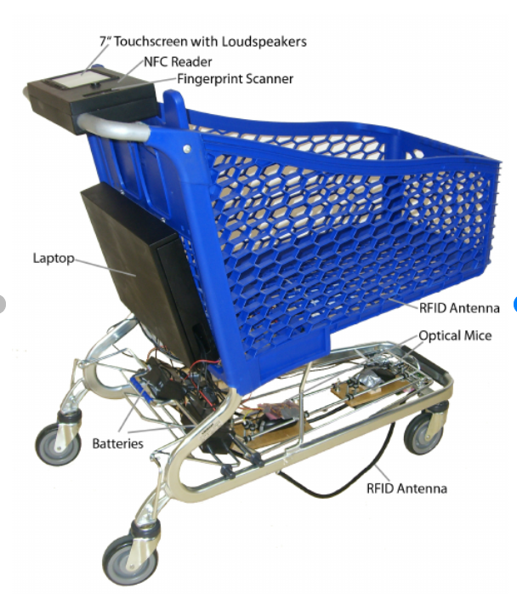
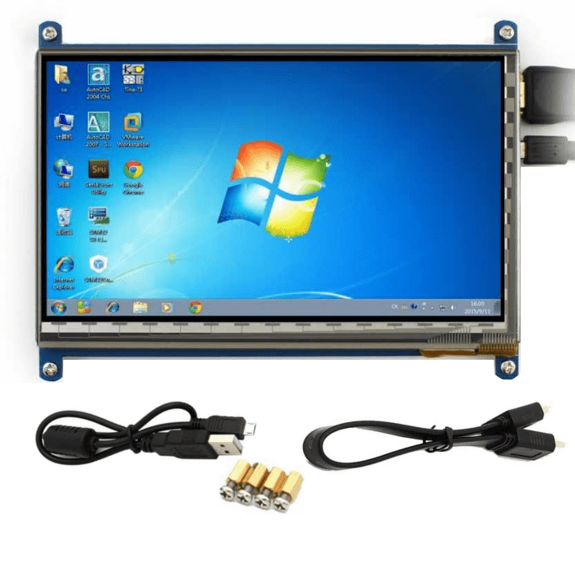
Category B model looks like after adding the display into it.
Cost : 4,120 rupees for 7inch display.

Slide 11
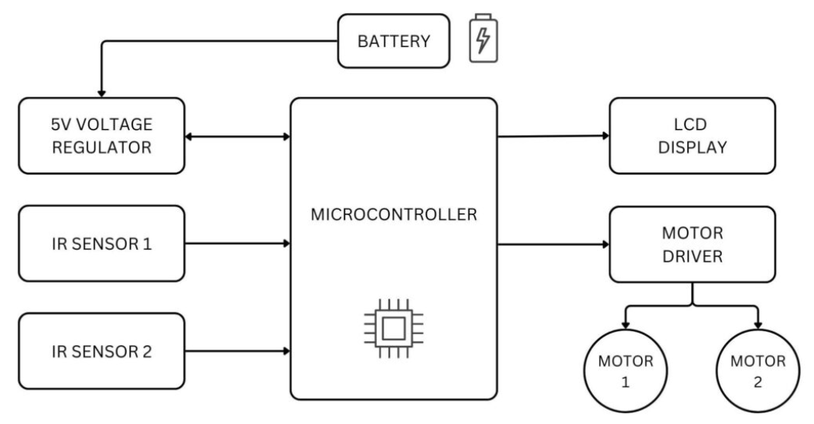
Model B : Circuit design extra PCB and removed Bluetooth transmitter and used 7inch lcd display coded with C and software interface react.
Arduino Board (e.g., Arduino Nano)
2x16 LCD Display
RFID Reader Module (e.g., MFRC522)
RFID Tags
Jumper Wires
Breadboard
Smartphone with Bluetooth capability
Bluetooth Module (e.g., HC-05)
External Power Source (e.g., 9V Battery)
Enclosure for the Trolley

Slide 12
FINANCIAL REPORT AND REVENUE

Slide 13
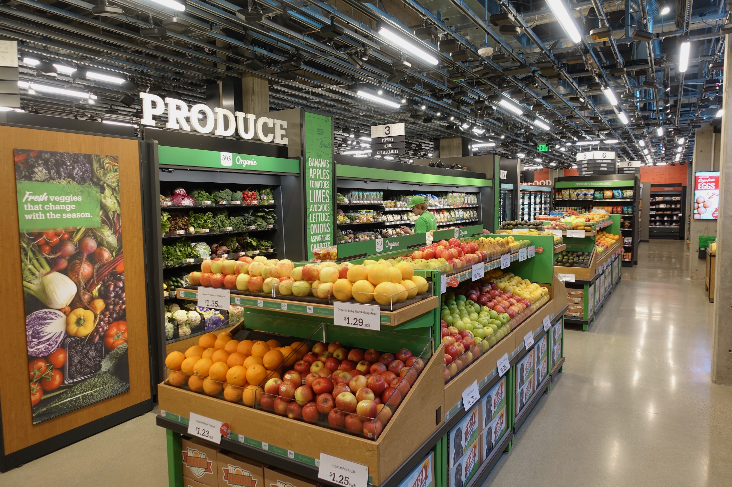
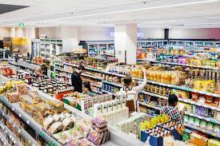
General store : 4000sqft
Average : 70-100 carts required
Our cart runs with
Subscription : 1.2%
Ad-revenue : 0.7%
Payment gateway : 0.3%
Total : 2.2%
If its 200 carts :
Ad-revenue : 1.1
Payment gateway : 0.8
Total : 3.7%
Ad-revenue & P.G directly propotional to net income (expontial)

Slide 14
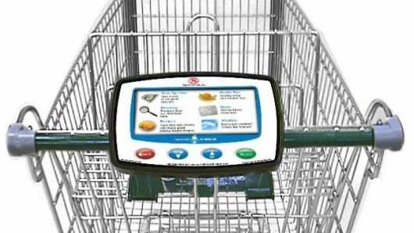
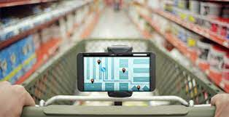
Subscription type
Catogy : A
Used : phone and transmitter wi-Fi
Cost : 7000rupees avg.
Charging retailer : 1.2% : 84 rupees pm
Our revenue : approx. : 108rupees including gateway and exclude maintainance
Cart monthly subscribe
Advertising : per month per user(0.5$)
Payment gateway: transations
Contract tender : as per applicable above 100units
Catogy : B
Used : 7inch display included
Cost : 11,000rupees avg.
Charging retailer : 1.2% : 132 rupees pm
Our revenue : 108rupees including gateway and exclude maintainance
Cart monthly subscribe
Advertising : per month per user(0.02$)
Payment gateway : transactions
Contract tender : as per applicable above 100units

Slide 15
Target market : Dmart like stores
Beginning market capture : Dmart 338 branches
162 Avg carts in Dmart ( approx. 4000sq ) : 100 carts.
176 large marts (around 46,000sq) : 200carts.
162 stores : 162 x 100 x 84 : 13,60,800 rupees per month.
176 stores : 176 x 200 x 132 : 46,46,400 rupees per month
Making charge of all carts : 11crore approx. whole sale price.
Permonth : 60lakhs permonth (annually 60% of our making with ad- revenue)
162 stores : 1.5cr approx. as per cashier salary
172 stores : 2.5 cr approx. as per cashier salary
3.4 cr profit for dmart market space

Slide 16
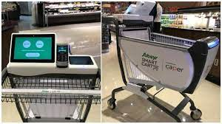
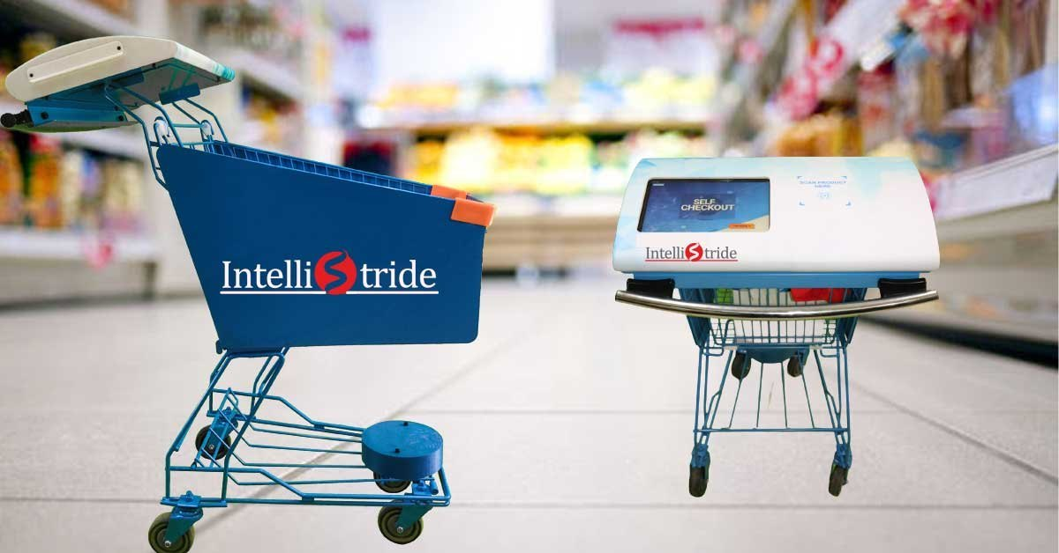
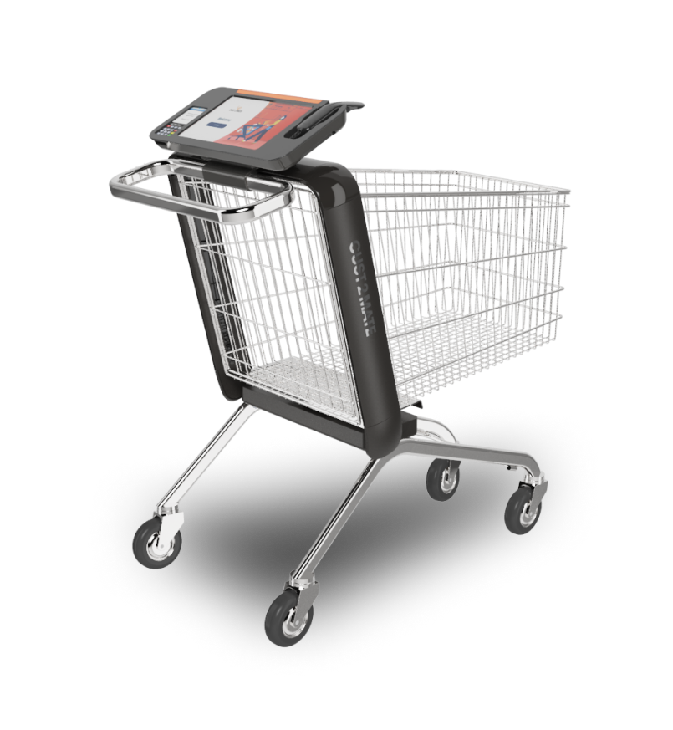
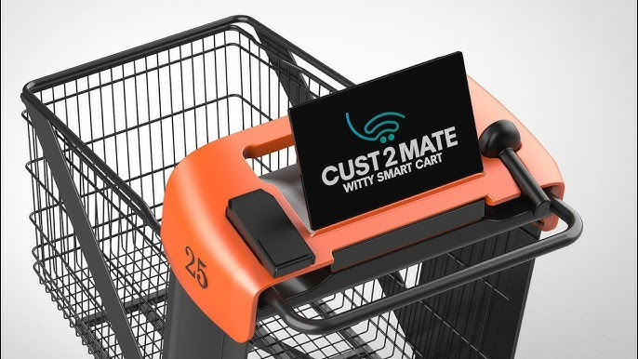
Competitor
Caper : Microsoft
Stores in US market space 6million USdollar
Intellistride : India
Stores in India market space N/A
Witty segment cust2mate : 17 Millon US dollar
Cust2mate
216 Millon US dollar

Slide 17
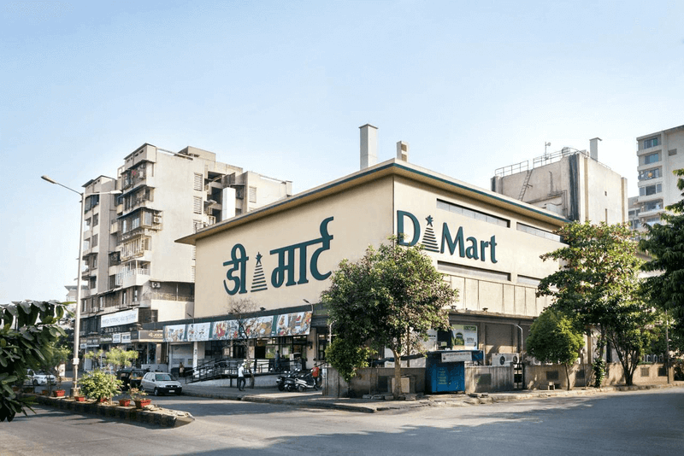
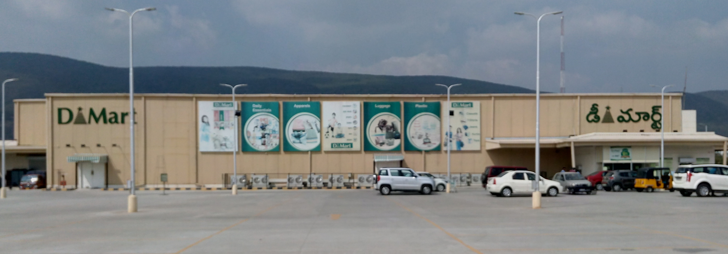
Survey report :
Store size small : 4000sqft
Product catorgy : A
No.of revenue generate per day : 1.13lakhs.
Sales perday : 21 lakhs.
Avg no of carts : 100.
Number of counters : 6 desk : 12 employee.
Average salary : 8000 rupees per employee.
No of malls : 162 across india.
Store size small : 46,000sqft
Product catorgy : B
No.of revenue generate per day : 3.63lakhs
Sales perday : 43 lakhs.
Avg no of carts : 200
Number of counters : 20 desk : 20 employee
Average salary : 12000 rupees per employee
No of malls : 176 across india

Slide 18
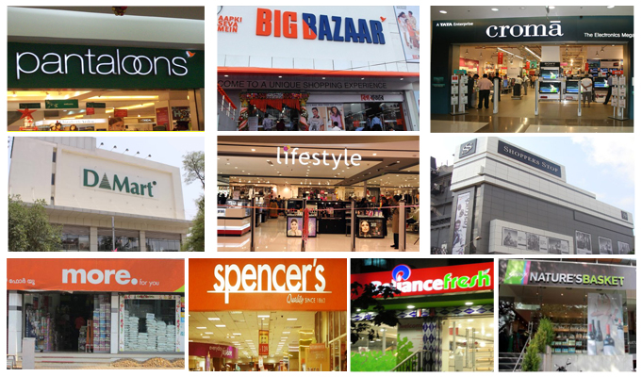
Further choosing franchise
Decatholon
Vishal mart
Bigbazar
More.
Reliance fresh etc..

Slide 19
Cart monthly subscribe : 2.5cr
Advertising : 2000perday users: 23L per month (0.5$)
Contract tender : as per applicable
Cart monthly subscribe : 1.5cr
Advertising : 1400per day users : 10L per month(0.5$)
Contract tender : as per applicable

Slide 20
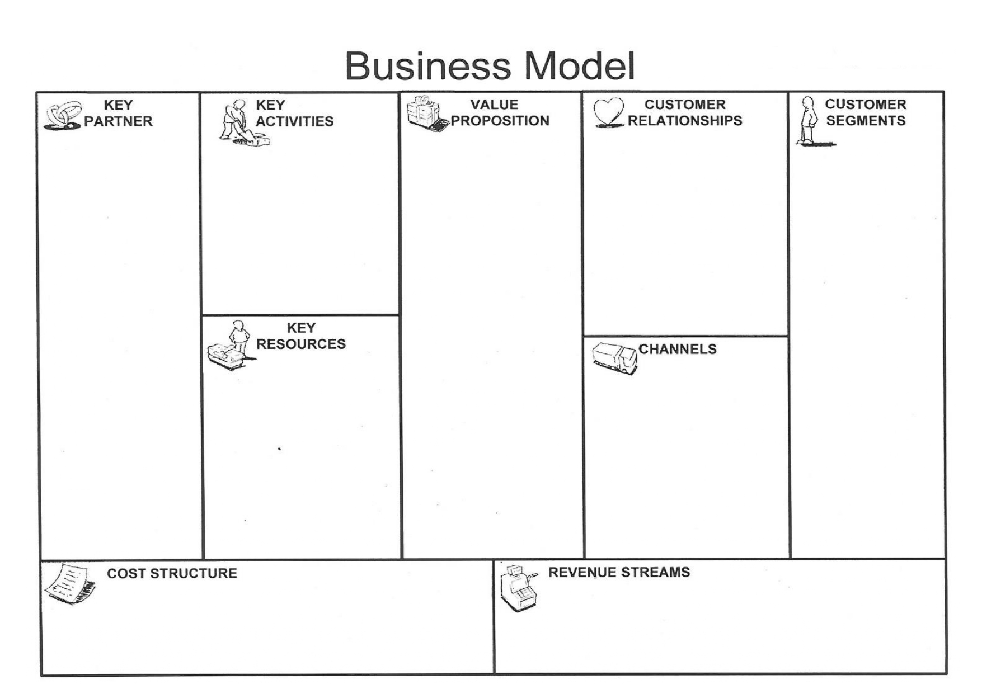
1)Supermarket & hypermarket
2)Payment processors
3)technology companies (for cloud computing and other IT services)
4) Advertisement
Sponsors
1)Operating with physical stores,
2)managing inventory, developing and maintaining 3)marketing and promoting the stores
4)providing customer service
1)No checkout lines
2)fast and convenient shopping experience
3)variety of products to choose from
4)competitive prices
5)high-quality products
Focus on convenience and speed, use data analytics to understand customer preferences and behaviors, offer loyalty programs and rewards, provide excellent customer service
Busy shoppers 1)who value convenience and speed,
2)shoppers who are comfortable with technology,
3)shoppers who live in urban areas or near business districts
1)Physical stores
2)Technology (sensors, cameras, software)
3)Inventory, employees
4)Funding and capital
Physical stores
online ordering
Rent and utilities, technology costs (hardware, software, maintenance), inventory costs, employee salaries, marketing and promotion costs
Sales of products, advertising revenue (from suppliers who want to promote their products in the cart display), fees from online transactions.

